Slide 1

CAPSTONE PROJECT
SECURE DATA HIDING IN IMAGE USING STEGANOGRAPHY
Presented By: Divyesh Dilip Jadhav
College Name: Datta Meghe College of Engineering
Department: Electronics and Telecommunication Engineering

Slide 2

OUTLINE
Problem Statement
Technology used
Wow factor
End users
Result
Conclusion
Git-hub Link
Future scope

Slide 3

PROBLEM STATEMENT
Develop a secure steganography method to embed confidential messages within digital images, ensuring data hiding without perceptible visual alterations. Implement password-based encryption/decryption to restrict unauthorized access, addressing vulnerabilities in traditional techniques that lack authentication. The solution must reliably encode and retrieve messages while maintaining image integrity and resisting detection.

Slide 4

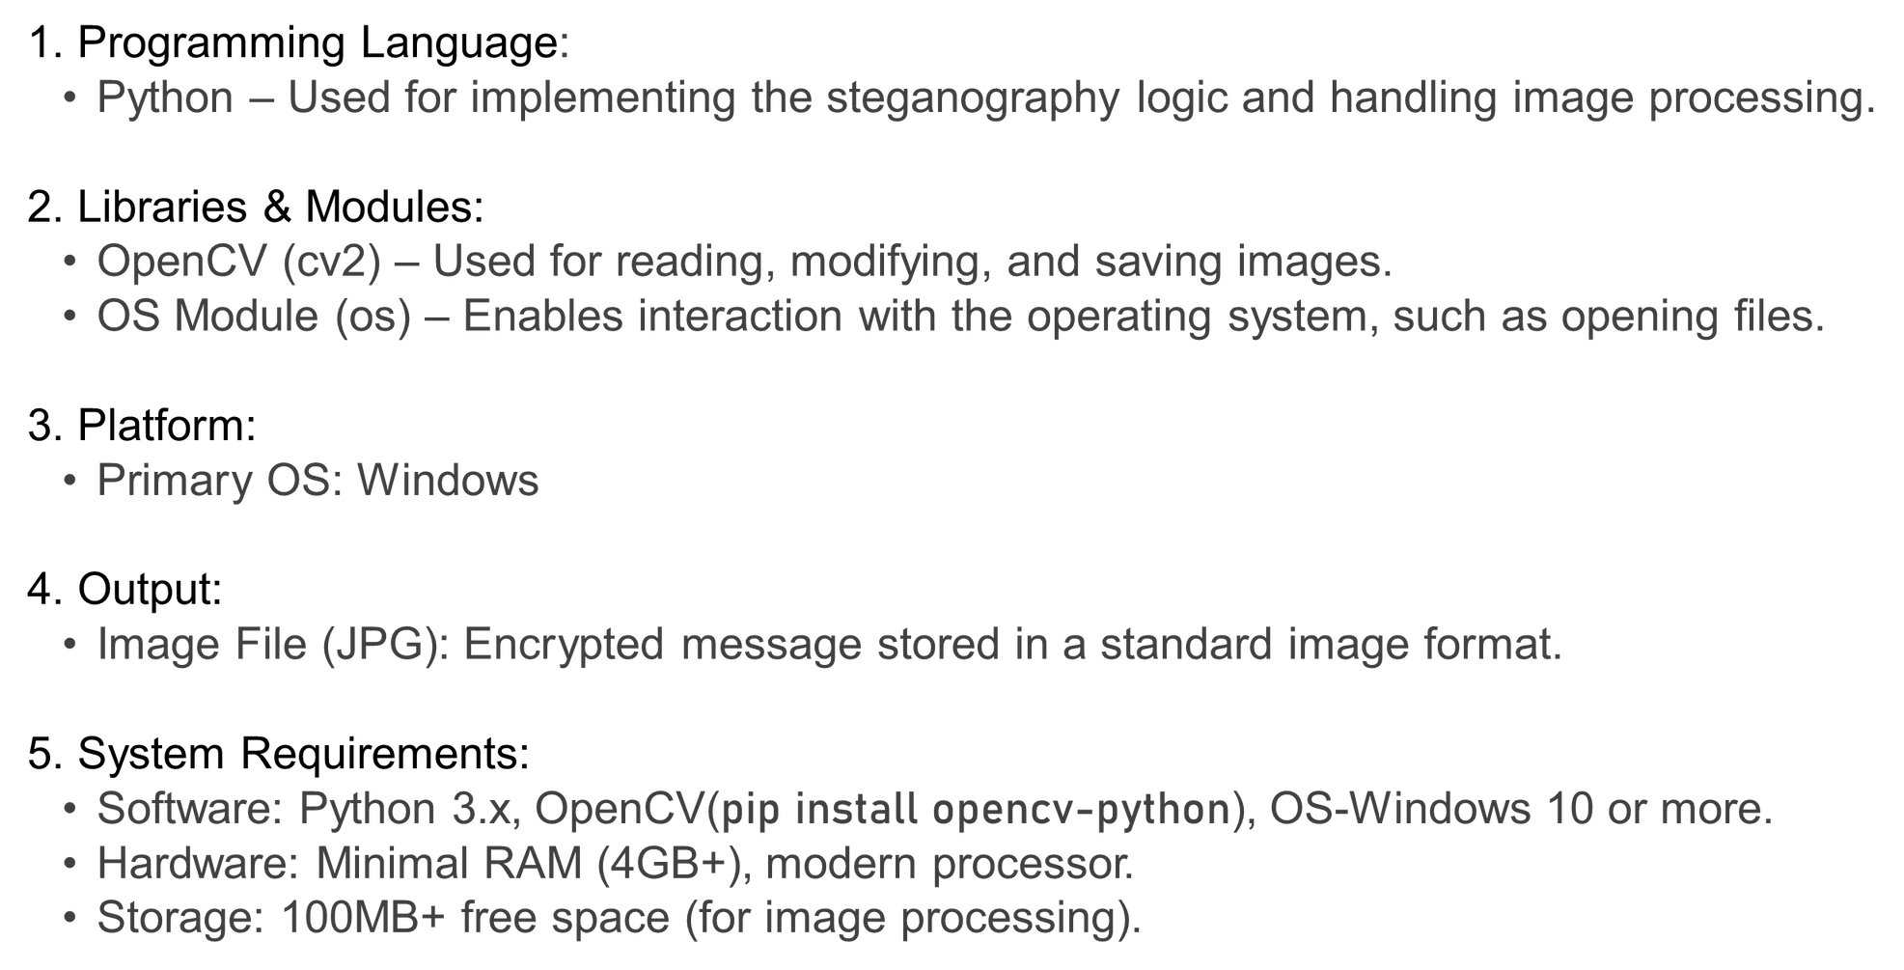

TECHNOLOGY USED

Slide 5

🔒 Dual-Layer Security:
Combines message embedding with password-protected decryption for enhanced safety.
🔄 Multi-Channel Embedding:
RGB Cycling: Distributes secret data across all 3 color channels (Red, Green, Blue), reducing visual anomalies and improving stealth.
🔐 RSA Integration Potential:
Enhanced Encryption: Can be upgraded with RSA algorithm to encrypt messages before embedding, adding asymmetric cryptographic security (public-private keys), making extraction futile without decryption.
🌐 Cross-Platform Compatibility:
Python-based implementation works seamlessly on Windows, Linux, and macOS.
💡 Simplicity & Scalability:
Minimal dependencies (OpenCV, OS) for easy deployment, yet supports advanced upgrades like RSA for enterprise use.
WOW FACTORS

Slide 6




1. Corporate Data Leak Prevention
Scenario:
A company hides patent blueprints in a marketing banner image.
Password + Stego: Employees access data via a secure portal after authentication.
Outcome: Prevents industrial espionage during file transfers.
END USERS
2. Military Covert Ops Communication
Scenario:
Field agents embed mission coordinates into a landscape photo.
Layered Security: RSA-encrypted message + steganography + self-destruct after decryption (future upgrade).
Outcome: Avoids interception by hostile actors.
3. Cybersecurity Classroom Demo
Scenario:
Professor uses the tool to teach steganography basics and RSA integration.
Activity: Students compete to find hidden messages in sample images.
Outcome: Hands-on understanding of data hiding and encryption.

Slide 7
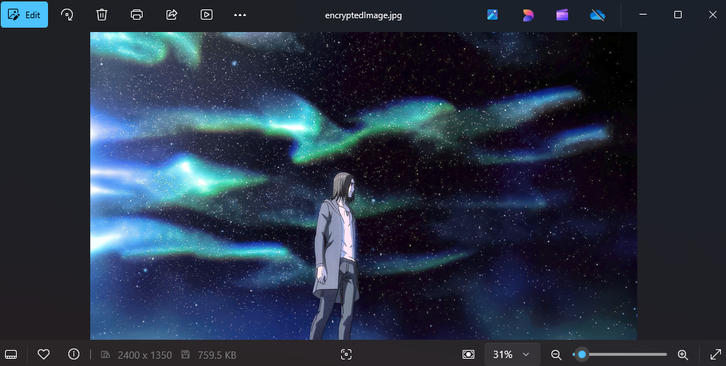
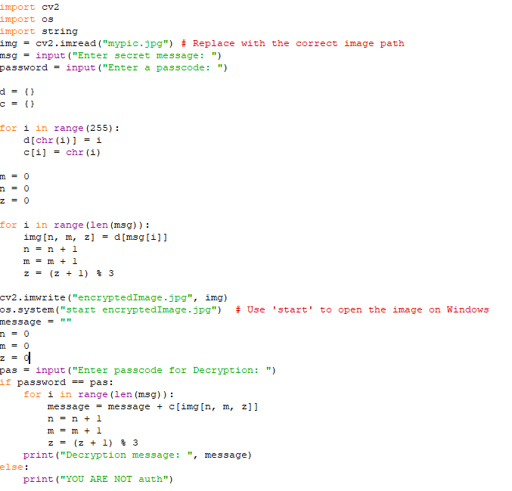
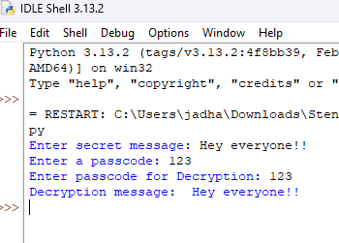

RESULTS

Slide 8

CONCLUSION
Addresses the need for secure communication by concealing messages within images.
Ensures confidentiality using steganography and password-based decryption.
Prevents unauthorized access, making data transmission more secure.
Can be extended with RSA encryption for enhanced security and scalability.
Beneficial for government agencies, corporations, journalists, and cybersecurity experts for secure data exchange.
Provides a practical and lightweight alternative to conventional encryption methods.

Slide 9

GITHUB LINK
https://github.com/divyeshjadhav/my_project.git

Slide 10

FUTURE SCOPE(OPTIONAL)
Enhanced Security with RSA Encryption – Implementing asymmetric encryption will strengthen message protection.
Integration with AI & Machine Learning – AI-driven steganography detection & optimization for improved security.
Mobile & Cloud Compatibility – Extending functionality to mobile apps and cloud platforms for real-time secure communication.
Multi-Layer Steganography – Embedding messages across multiple layers of images for added security.
Improved Compression Techniques – Ensuring high-quality image retention while embedding larger messages.
Application in Cybersecurity & Digital Forensics – Used for covert communication, forensic investigations, and data protection.

Slide 11

THANK YOU

